Slide 1


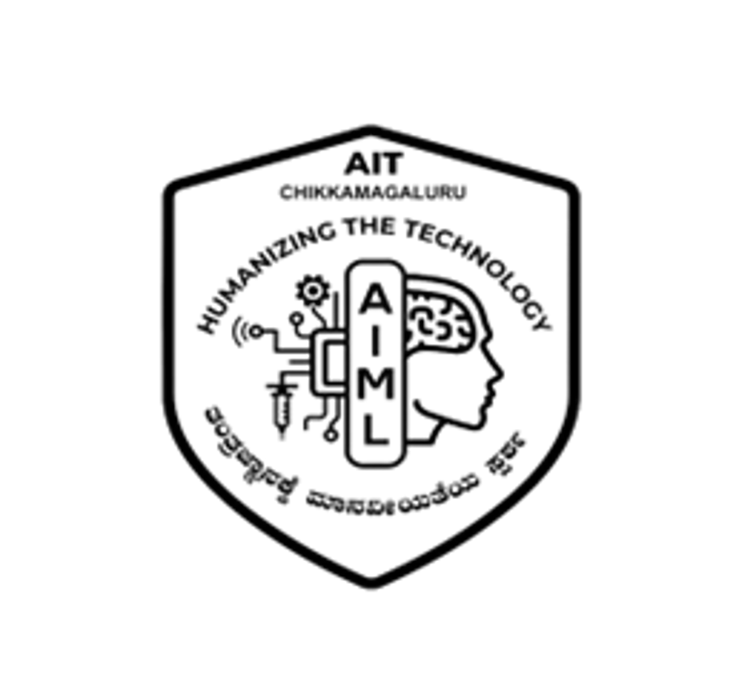
|| Jai Sri Gurudev ||
ADICHUNCHANAGIRI INSTITUTE OF TECHNOLOGY
(Affiliated to Visvesvaraya Technological University, Belagavi | Accredited by NAAC)
Chikkamagaluru – 577 102, Karnataka
DEPARTMENT OF ARTIFICIAL INTELLIGENCE AND MACHINE LEARNING
MINI PROJECT SYNOPSIS PRESENTATION [BAI586]
on
DEVELOPMENT OF AN IOT AND AI-ENABLED ROVER
FOR REAL-TIME CROP HEALTH MONITORING
Academic Year : 2026 – 2027
Under the guidance of :
  Ms. Sathyabhama R, _{B.E., M.Tech}
  Assistant Professor,
  Dept. of AI & ML,
  AIT, Chikkamagaluru.
Presented by :
  Navyashree B H (4AI24AI035),
  Shreyas R S (4AI24AI048),
  Sumaiya Firdoes (4AI24AI051),
  Tejaswini D (4AI24AI055),
  5th Semester,
  Dept. of AI & ML,
  AIT, Chikkamagaluru.

Slide 2
AGENDA
1
Abstract
8
Scope of the Project
2
Introduction
9
Hardware & Software Requirements
3
Literature Survey
10
System Architecture
4
Motivation
11
Future Scope
5
Problem Statement
12
References
6
AIM
13
Thank You
7
Objectives

Slide 3
ABSTRACT
Existing systems for checking crops depend mostly on farmers inspecting the field by hand, or on fixed sensors that cover only a few spots. Because of this, crop problems are found late, which leads to crop loss and water waste.
🌾
Proposed system, the IoT-Enabled AI-Based Smart Farming Rover, is a small robot vehicle that moves through the field. Its ESP32 controllers, sensors and camera collect crop and field information and send it over Wi-Fi to a backend and database, and a web and mobile dashboard shows live data and alerts. AI-assisted analysis of crop images is proposed to help find crop and field risks, and soil-moisture and weather data support irrigation guidance.
🤖

Slide 4
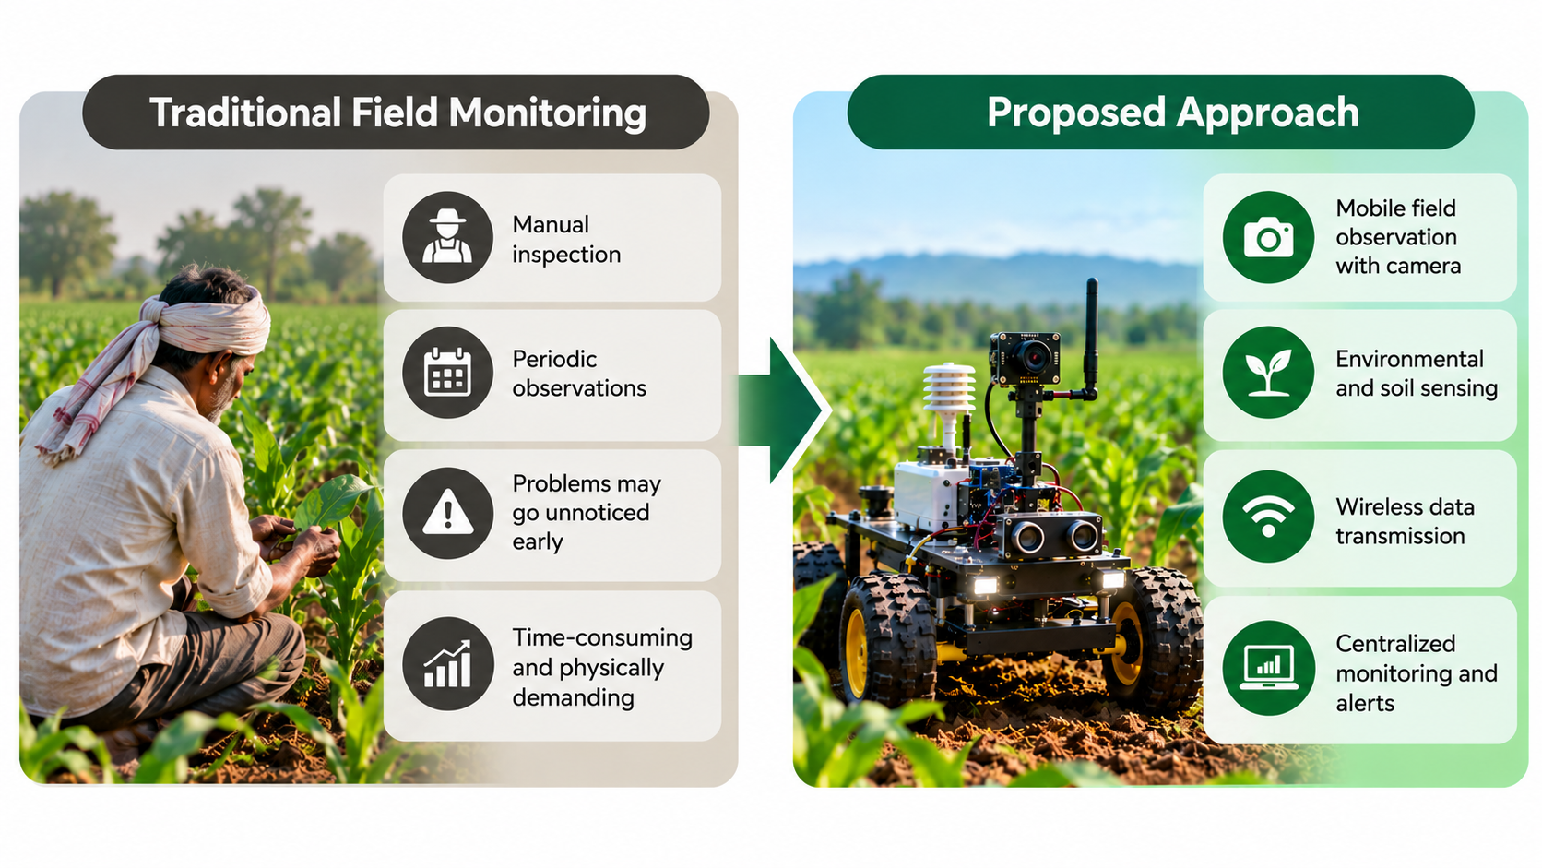
INTRODUCTION
Agriculture is a main source of income and food, and a good harvest depends on knowing the condition of crops and fields on time. Crops face diseases, pests, lack of nutrients and water shortage, along with heavy rain, drought, floods, heat and fire. Checking fields by hand is slow and tiring, and hard to do for large or far-away fields, so problems may be noticed late.
Three technologies can help:
IoT: sensors measure soil and weather conditions continuously at low cost.
Robotics: a rover carries sensors and a camera directly into the field.
AI and computer vision: help understand field images and sensor data.
Joining these in one field-ready rover gives farmers real-time field information to support their decisions.

Slide 5
LITERATURE SURVEY
SL.NO | AUTHOR | TITLE | PROPOSED METHOD | DRAWBACK
1 | A. Tzounis, N. Katsoulas, T. Bartzanas and C. Kittas | Internet of Things in agriculture, recent advances and future challenges | Smart Farming Sensors: Connected sensors measure soil, weather and crop conditions and send the data to farmers remotely. | Sensors sit at fixed spots, cover small areas and give no pictures of crops.
2 | O. Elijah, T. A. Rahman, I. Orikumhi, C. Y. Leow and M. N. Hindia | An overview of Internet of Things (IoT) and data analytics in agriculture: Benefits and challenges | IoT with Data Analytics: Farm sensor data is analysed to guide crop care and water use. | Needs steady internet and a costly set-up for small farms.
3 | S. P. Mohanty, D. P. Hughes and M. Salathé | Using deep learning for image-based plant disease detection | AI for Crop Images: AI programs find plant diseases from leaf pictures with good accuracy. | Mostly trained on sample photos and not linked with live field data.
4 | K. P. Ferentinos | Deep learning models for plant disease detection and diagnosis | Deep Learning Models: Neural networks trained on leaf images name the disease from a photo. | Tested on lab-style images; accuracy may drop on field photos.

Slide 6
LITERATURE SURVEY (contd…)
SL.NO | AUTHOR | TITLE | PROPOSED METHOD | DRAWBACK
5 | M. Ayaz, M. Ammad-Uddin, Z. Sharif, A. Mansour and E.-H. M. Aggoune | Internet-of-Things (IoT)-based smart agriculture: Toward making the fields talk | Smart Watering: Soil moisture and weather readings decide when to water, which saves water. | Often uses only one reading and ignores weather and crop condition.
6 | K. G. Liakos, P. Busato, D. Moshou, S. Pearson and D. Bochtis | Machine learning in agriculture: A review | Machine Learning Review: Surveys how machine learning predicts yield, disease and water needs from farm data. | Only a review; it gives no working system that joins sensors and a robot.
7 | A. Bechar and C. Vigneault | Agricultural robots for field operations: Concepts and components | Farm Robots: Robots help with checking, spraying and harvesting. | Costly, and each robot usually does only one job.

Slide 7
LITERATURE SURVEY (contd…)
SL.NO | AUTHOR | TITLE | PROPOSED METHOD | DRAWBACK
8 | W. Shi, J. Cao, Q. Zhang, Y. Li and L. Xu | Edge computing: Vision and challenges | Edge Computing: Data is processed close to where it is collected, so answers are quicker and less internet is needed. | Small controllers have limited power, so work must be shared with a server.
9 | S. Wolfert, L. Ge, C. Verdouw and M.-J. Bogaardt | Big data in smart farming – A review | Data-Driven Farming: Weather, satellite and field data are combined with AI to support farm decisions. | Such data is rarely combined with close-up field data from low-cost rovers.
10 | A. Kamilaris and F. X. Prenafeta-Boldú | Deep learning in agriculture: A survey | Deep Learning Survey: Reviews how deep learning is used on farm images and data for many farming tasks. | Needs large labelled datasets and strong computers, which small farms lack.

Slide 8
MOTIVATION
1
Crop problems grow slowly and are easier to fix when found early
10–30%
0%
100%
of crop production is estimated to be lost to insect pests, diseases and weeds
Source: Ministry of Agriculture, Rajya Sabha Unstarred Q. 1696 (4 Dec 2009)
[View Source ↗]
2
Checking every part of a field by hand all the time is not practical
51%
of India's net sown area is rainfed, supplying 41% of food production
Source: Gopinath K. A. et al., ICAR-CRIDA, Indian Farming, 2022
Field checking is tiring and can be unsafe during fire or bad weather
[View Source ↗]
3
Risk grows when problems are seen late
AGRIVISION MONITORING APPROACH
4
Watering decisions are often made without reliable soil and weather data
Camera view
Field sensors
Live dashboard
ESP32-CAM
soil, rain, temperature, humidity
telemetry over Wi-Fi
Sensors + AI + a robot vehicle = continuous, remote and early information for farmers
Notes:
SOURCES FOR THE TWO STATISTICS
1) 10–30% of crop production estimated lost to insect pests, diseases and weeds
Ministry of Agriculture (Govt. of India), reply to Rajya Sabha Unstarred Question No. 1696 'Loss of crop yield due to pest attacks' (Dr. Ram Prakash), by Prof. K.V. Thomas, Minister of State, 4 December 2009; Rajya Sabha Debates Vol. 218 No. 11. Wording: 'It is estimated that crop losses due to insect pest, diseases and weeds range between 10 to 30 per cent annually, depending on severity of pest attack.' This is an estimate, not a measured national figure.
https://cms.rajyasabha.nic.in/UploadedFiles/Debates/OfficialDebatesDatewise/Floor/218/F04.12.2009.pdf
2) 51% of net sown area rainfed, supplying 41% of food production
Gopinath K A, Amrutsagar V M, Patel N I, Venkatesh G, Kumar V, Borko B, Rai A P, Bhatt S N, Nataraja K C, Rajkumar B, Raul A, Singh V K. 'Potential of organic farming in rainfed areas of India', Indian Farming, ICAR-Central Research Institute for Dryland Agriculture, Hyderabad, 2022, pp. 59-62. Wording: 'about 51% of the net sown area is rainfed contributing 41% of the total food production'.
Landing page: https://epubs.icar.org.in/index.php/IndFarm/article/view/131391
PDF: https://epubs.icar.org.in/index.php/IndFarm/article/download/131391/48725/344645
Note: an earlier version of this slide cited Lok Sabha Q. 1188 (3 March 2015) at https://eparlib.nic.in/bitstream/123456789/663086/1/17469.pdf; that server could not be opened from the presentation machine, so it was replaced by the verified Rajya Sabha document above. The statistics motivate the project; they do not show that AgriVision prevents losses.

Slide 9
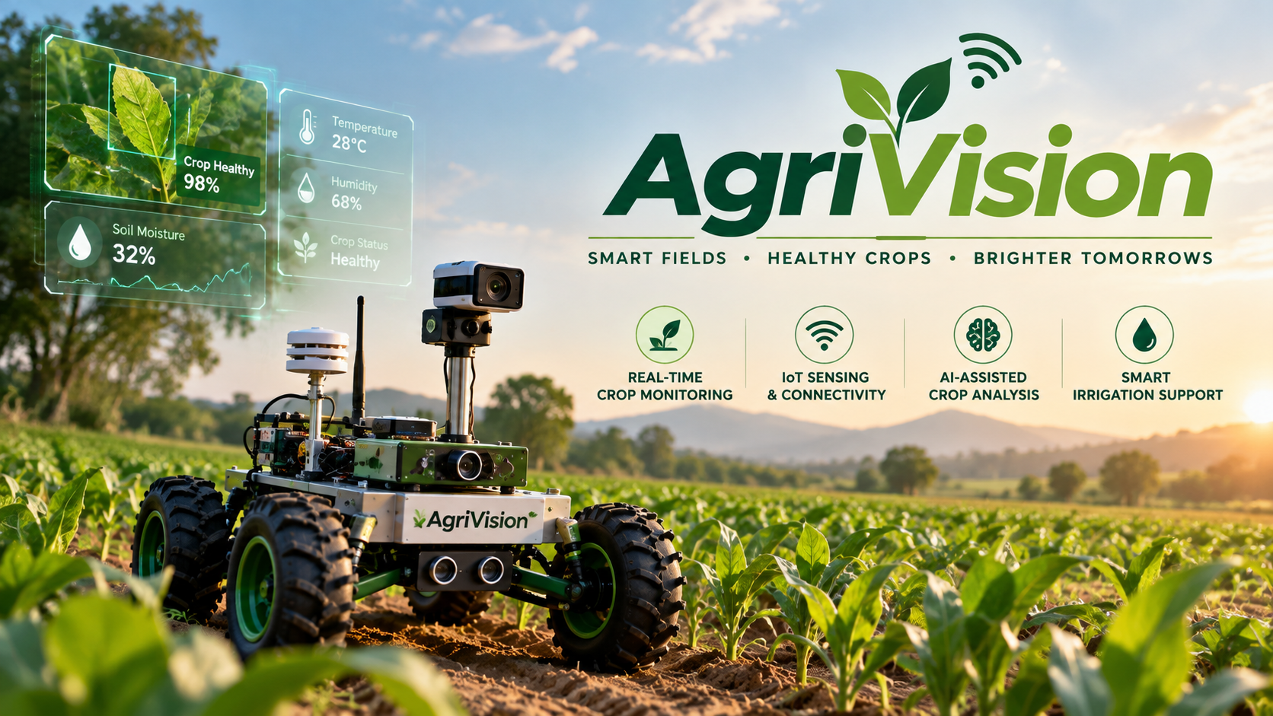
PROBLEM STATEMENT
Agricultural productivity is affected by crop diseases, pest infestations, nutrient deficiencies, water stress and other environmental risks. Conventional monitoring depends largely on periodic manual inspection, which may delay the identification of emerging problems and is difficult to scale across large or remote fields.
There is therefore a need for a field-deployable intelligent monitoring system capable of continuously collecting and analysing crop and environmental information. This project develops an IoT-enabled, AI-based agricultural rover to provide real-time field information and actionable decision support.

Slide 10










AIM
1 INPUT
2 PROCESS
3 OUTPUT
Field data collected
Hardware and software pipeline
Information for the farmer
Embedded data acquisition
Environmental sensor readings
ESP32 controllers
Real-time field status
Temperature, humidity, soil moisture, rain
Live web dashboard
Wireless transmission
WebSocket (telemetry, commands); HTTP/MJPEG (camera)
ESP32-CAM field images
Backend processing
Alerts
Camera stream from the rover
Node.js / Express server
Warnings about field conditions
Data storage
MongoDB database
External weather and environmental data
Decision-support information
Public weather / environmental sources
AI / computer-vision-assisted analysis
Through web and mobile interfaces
Proposed analysis stage

Slide 11






OBJECTIVES
Crop Health
Less Manual Monitoring
Smarter Water Management
To support earlier detection of crop and field risks through camera observation and AI-assisted analysis
To reduce repeated manual inspection with a rover that moves through the field and detects obstacles
To give soil-moisture and weather-based guidance to support irrigation decisions
Camera, computer vision; AI analysis proposed
Driver ESP32, motors, ultrasonic sensors
Soil-moisture and rain sensors, weather data
Environmental Awareness
Risk Alerts and Remote Monitoring
Historical Analysis
To sense temperature, humidity, soil moisture, rain and flame in the field
To give rainfall, heat and fire-related alerts and live data on web and mobile
To store field data so past readings can be reviewed for trends
Sensor ESP32: DHT11, soil, rain, flame
Wi-Fi: WebSocket / HTTP, web dashboard
Backend, MongoDB
To validate the integrated prototype
Rover, sensors, camera, controllers, communication, backend, database and dashboard working together.
Intended benefits; not yet measured in field trials. Autonomous navigation, GPS mapping and automated irrigation are future scope.

Slide 12
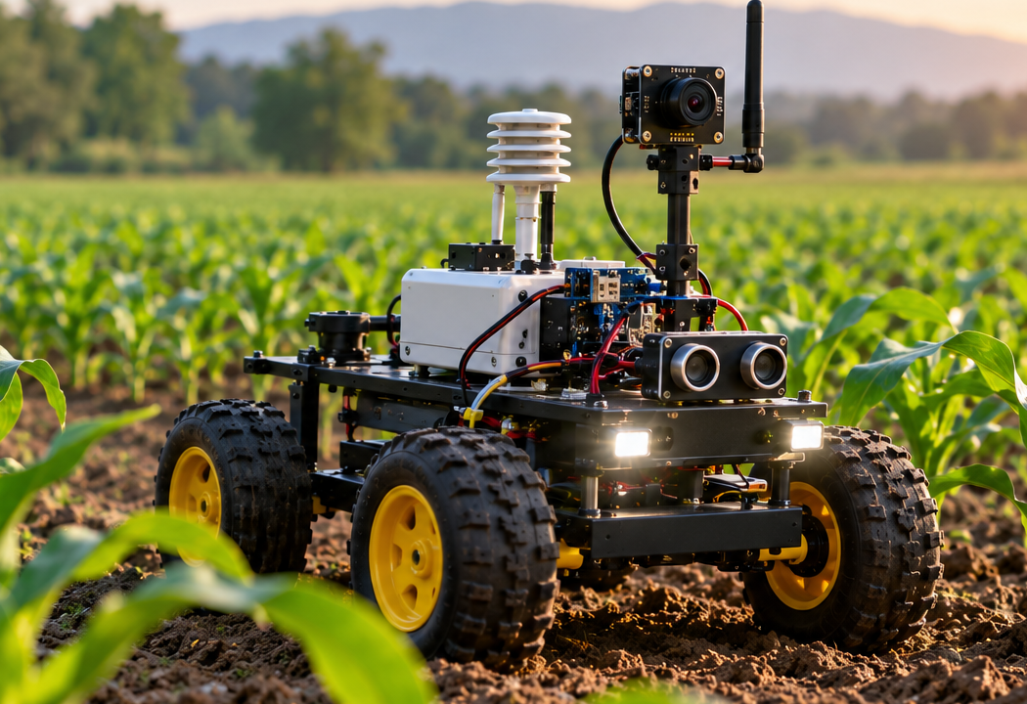
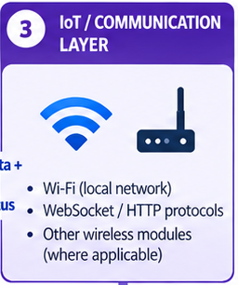
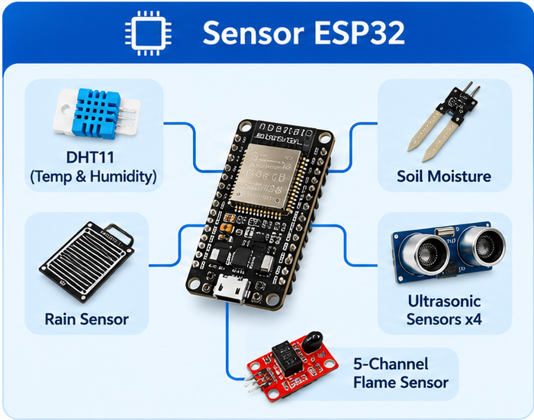
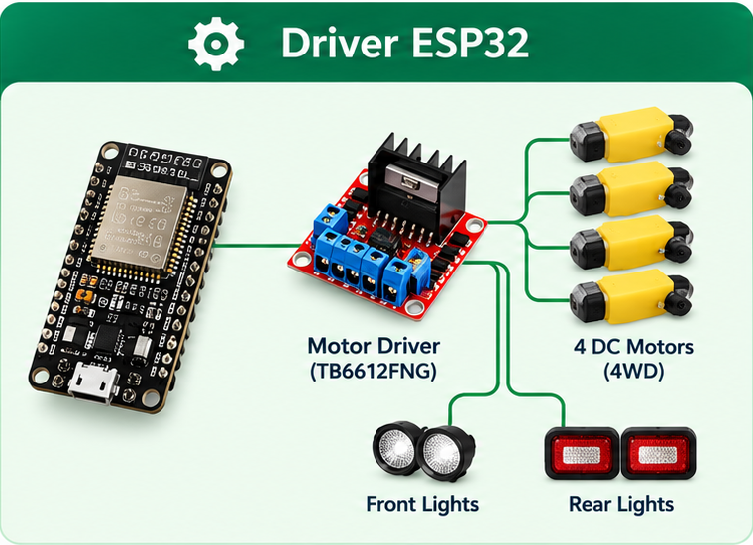
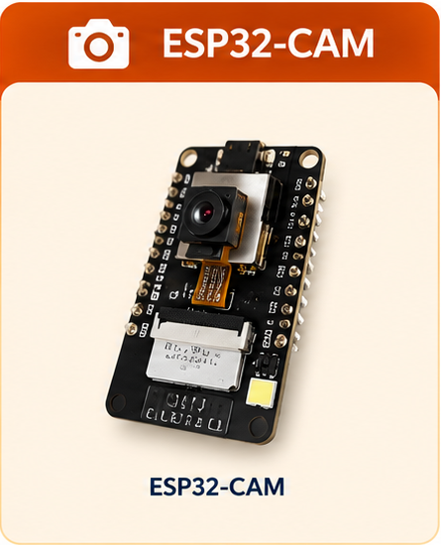
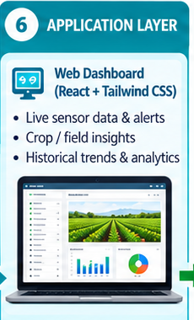
SCOPE OF THE PROJECT
Agriculture
Internet of Things (IoT)
Rover-based crop and field monitoring, irrigation guidance and risk monitoring
Wi-Fi based WebSocket / HTTP data transfer between rover and software
Embedded Systems
Robotics
ESP32 controllers reading temperature, humidity, soil moisture, rain and flame sensors
Motor-driven rover movement with obstacle detection
Computer Vision and AI
Web and Data Analytics
Camera-based crop and field observation; AI-assisted analysis of crop and field risks (proposed)
Live data on web and mobile interfaces; stored field data for trend review

Slide 13
HARDWARE COMPONENTS
Component | Purpose | Role
ESP32 Dev Modules (×2) | Sensor handling, motor control, IoT communication | Control & IoT
ESP-CAM Module | Captures and streams field images over Wi-Fi | Vision
DHT11 Sensor | Measures air temperature and humidity | Environmental Sensing
Soil Moisture Sensor | Measures soil moisture level | Environmental Sensing
Rain Sensor | Detects rainfall | Environmental Sensing
5-Channel Flame Sensor | Detects fire/flame in multiple directions | Hazard Detection
Ultrasonic Sensors (×4) | Obstacle detection and distance measurement | Navigation Safety
Servo Motors | Camera and sensor positioning | Actuation
BO DC Motors (×4) | Drive the rover wheels | Mobility
TB6612FNG Motor Drivers (×2) | Control motor direction and speed | Mobility
Buzzer | Audible alerts for fire, obstacles or hazards | Alert System
Rover Chassis & Wheels | Mounts all components and enables movement | Mechanical Structure
Power Subsystem | Supplies power to controllers, sensors and motors | Power

Slide 14
SOFTWARE AND TECHNOLOGIES
Category | Technology | Purpose
Embedded Firmware | Embedded C/C++ (ESP32) | Sensor acquisition and motor control
Frontend | React, Tailwind CSS | Web dashboard and mobile interface
Backend | Node.js, Express.js | Data ingestion, APIs and processing
Database | MongoDB | Storage of sensor, image and alert data
Communication | Wi-Fi, WebSocket / HTTP | Real-time data transfer
AI / Computer Vision | Python, OpenCV, AI/ML | Image and data analysis
External Data | Environmental / public APIs | Weather, rainfall and environmental information

Slide 15
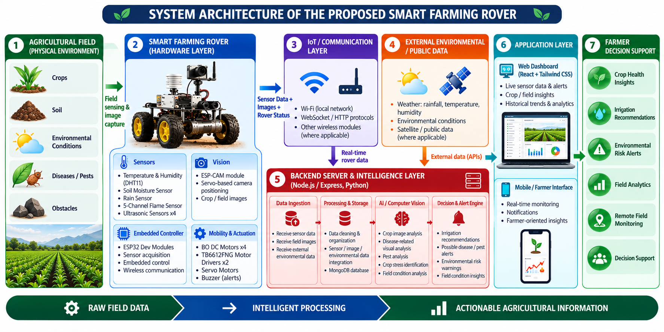
SYSTEM ARCHITECTURE

Slide 16
FUTURE SCOPE
Self-driving rover with path planning
GPS-based field maps
🧭
🗺
The rover would follow planned paths along the crop rows by itself. Today it is driven from the dashboard.
GPS tags would place every reading and image on a map of the field, so the farmer sees where a problem is.
Automatic watering control
Cloud-based data analysis
💧
☁
Soil-moisture and weather data could start watering automatically, instead of only advising the farmer.
Field data would be analysed in the cloud to compare fields and seasons and show trends over time.
Also planned: drones, many rovers working together and crop and weather predictions

Slide 17
REFERENCES
[1] A. Tzounis, N. Katsoulas, T. Bartzanas and C. Kittas, "Internet of Things in agriculture, recent advances and future challenges," Biosystems Engineering, vol. 164, pp. 31–48, 2017.
[2] O. Elijah, T. A. Rahman, I. Orikumhi, C. Y. Leow and M. N. Hindia, "An overview of Internet of Things (IoT) and data analytics in agriculture: Benefits and challenges," IEEE Internet of Things Journal, vol. 5, no. 5, pp. 3758–3773, 2018.
[3] S. P. Mohanty, D. P. Hughes and M. Salathé, "Using deep learning for image-based plant disease detection," Frontiers in Plant Science, vol. 7, Art. 1419, 2016.
[4] K. P. Ferentinos, "Deep learning models for plant disease detection and diagnosis," Computers and Electronics in Agriculture, vol. 145, pp. 311–318, 2018.
[5] M. Ayaz, M. Ammad-Uddin, Z. Sharif, A. Mansour and E.-H. M. Aggoune, "Internet-of-Things (IoT)-based smart agriculture: Toward making the fields talk," IEEE Access, vol. 7, pp. 129551–129583, 2019.
[6] K. G. Liakos, P. Busato, D. Moshou, S. Pearson and D. Bochtis, "Machine learning in agriculture: A review," Sensors, vol. 18, no. 8, Art. 2674, 2018.
[7] A. Bechar and C. Vigneault, "Agricultural robots for field operations: Concepts and components," Biosystems Engineering, vol. 149, pp. 94–111, 2016.
[8] W. Shi, J. Cao, Q. Zhang, Y. Li and L. Xu, "Edge computing: Vision and challenges," IEEE Internet of Things Journal, vol. 3, no. 5, pp. 637–646, 2016.
[9] S. Wolfert, L. Ge, C. Verdouw and M.-J. Bogaardt, "Big data in smart farming – A review," Agricultural Systems, vol. 153, pp. 69–80, 2017.
[10] A. Kamilaris and F. X. Prenafeta-Boldú, "Deep learning in agriculture: A survey," Computers and Electronics in Agriculture, vol. 147, pp. 70–90, 2018.
[11] FAO, The Future of Food and Agriculture – Trends and Challenges. Rome: Food and Agriculture Organization of the United Nations, 2017.
[12] Espressif Systems, ESP32 Technical Reference Manual. [Online]. Available: https://www.espressif.com
[13] G. Bradski, "The OpenCV Library," Dr. Dobb's Journal of Software Tools, 2000.

Slide 18


